Slide 1
FYP Ⅰ
Presentation

Slide 2
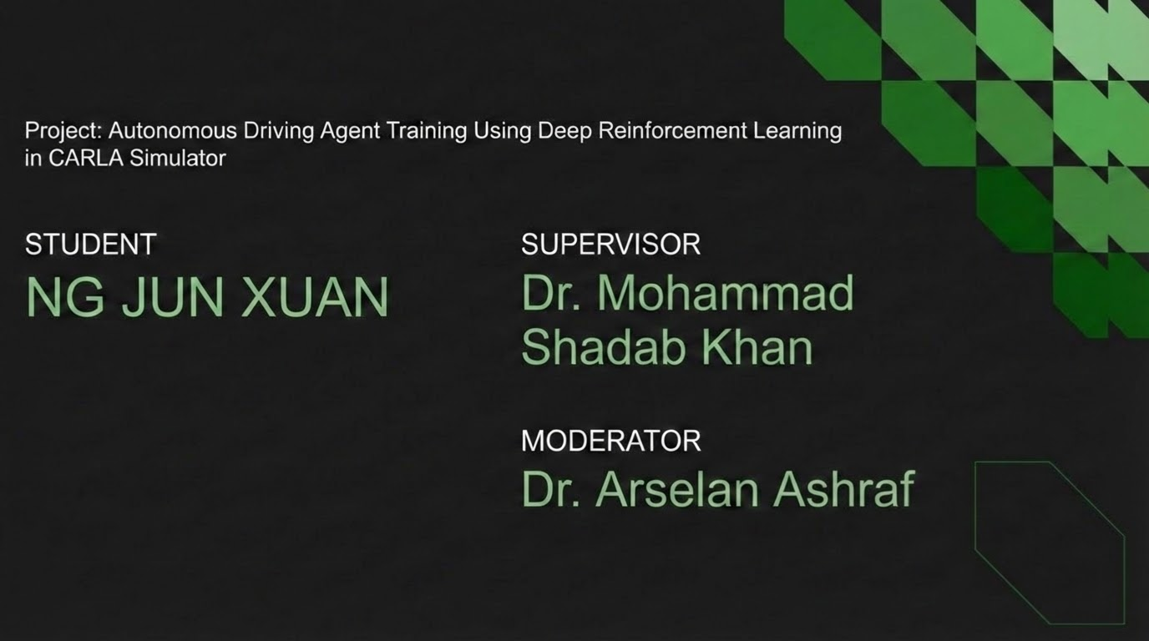

Slide 3
Presentation
overview
Introduction
Literature Review
Algorithm Performance Comparison
High-risk scenario risk assessment
Transformer Architecture in AD
Implementation Plan
Conclusion and Outlook

Slide 4
Introduction

Slide 5
Problem Statement
Reinforcement learning shows high potential in autonomous driving tasks.
Safety performance differences among various RL algorithms using the Transformer architecture remain unclear.
Introduction

Slide 6
Objective of the Research
Objective 1
To systematically identify the most commonly used Transformer-based model and reinforcement learning algorithms in autonomous driving tasks.
Objective 2
To quantitatively compare the safety performance of reinforcement learning algorithms under comparable driving scenarios.
Objective 3
To rank the risk levels of different high-risk autonomous driving scenarios using a consistent set of safety metrics.
Introduction

Slide 7
Research Question
RQ 1
What are the differences in safety performance among different reinforcement learning algorithms in similar high-risk driving scenarios?
Main RQ
In a Transformer-based architecture, what are the differences in safety performance among different reinforcement learning algorithms in high-risk autonomous driving scenarios?
RQ 2
What are some commonly used Transformer-based models in high-risk autonomous driving tasks?
RQ 3
What are the differences between different high-risk scenarios?
Introduction

Slide 8
Literature Review

Slide 9
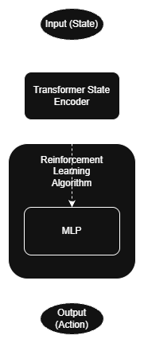
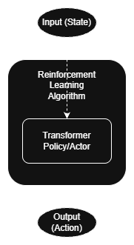
Common Architectural Design: Encoder vs. Policy
Transformer as State Encoder
Transformer as Actor/Policy
Preprocess the input vector for MLP
Transformer can handle time-series data
Train faster than LSTM and RNN
Transformer directly replace the MLP
Transformer can handle time-series data
Literature Review

Slide 10
Introducing Reinforcement Learning Algorithms (SAC, PPO,DDPG, TD3)
SAC (Soft Actor-Critic)
PPO (Proximal Policy Optimization)
DDPG (Deep Deterministic Policy Gradient)
TD3 (Twin Delayed Deep Deterministic Policy Gradient)
Action Space
Continuous
Discrete / Continuous
Continuous
Continuous
Sample Efficiency
Off-policy
On-policy
Off-policy
Off-policy
Policy Type
Actor-Critic
Actor-Critic
Actor-Critic
Actor-Critic
Maximum Entropy RL: Introduces an entropy term to the reward function to encourage exploration and enhance agent robustness.
Clipped Surrogate Objective: Restricts the probability ratio of new/old policies to a safe range to prevent policy collapse.
Deterministic Policy Gradient: Adapts DQN principles (Experience Replay and Target Networks) for high-dimensional continuous action spaces.
Twin Delayed Mechanism: Implements Clipped Double-Q learning to address value overestimation and delays policy updates for better stability.
Core mechanisms and innovations
Literature Review

Slide 11
Classification and Definition of High-Risk Scenarios
Merging
Roundabout
In the absence of traffic lights, it is necessary to observe, predict, and negotiate right-of-way with traffic flows from multiple directions.
This involves merging, circling, and exiting continuous traffic flows.
Intersection
Highway
This includes intersections without traffic lights, four-way intersections, left-turn intersections, and right-turn intersections.
It primarily involves overtaking task.
LIterature Review

Slide 12
Algorithm Performance Comparison
Calculation of Minimum, Mean (Average), and Maximum values for key safety indicators
Evaluating the safety performance of mainstream algorithms (SAC, PPO, DDPG, TD3) primarily based on Average Value Comparisons

Slide 13
Algorithm performance analysis
(Low performance < High performance)
Support papers
Result 1
PPO < SAC
(Liu et al., 2024), (Chowdhury et al., 2024), (L. Gao et al., 2025), (Elallid et al., 2024), (Huynh & Nguyen, 2024)
Result 2
SAC ≈ DDPG/TD3
(Fan et al., 2024)
Result 3
PPO < DDPG/TD3
(R. Zhao et al., 2025), (Zhao et al., 2024)
Result 4
DDPG/TD3 < SAC < PPO
(Zhang et al., 2025)
Result 4.1
DDPG/TD3 < SAC
(Zhang et al., 2025)
Result 4.2
SAC < PPO
(Zhang et al., 2025)
Result 4.3
DDPG/TD3 < PPO
(Zhang et al., 2025)
Algorithm Performance Comparison

Slide 14
High-risk scenario risk assessment
This chapter summarizes and extracts data from all relevant papers and calculates their minimum, mean, and maximum values.
Different comparison methods are used for different indicators
Higher collision rates, collision time and lane deviation are considered high risk.
Higher success rates are considered low risk.

Slide 15
Scenario risk analysis
(Low risk < High risk)
Support papers
Equation 1
Left turn intersection < Merging
(L. Gao et al., 2025)
Equation 2
Roundabout < Right turn intersection
(Elallid et al., 2024)
Equation 3
Roundabout < Intersection
(Yun & Cao, 2024)
Equation 4
Highway < Intersection
(Prasath A & Navaz K, 2025)
Equation 5
Highway < Left turn intersection
(Hu et al., 2024)
Equation 6
Left turn intersection < Merging < Roundabout
(Liu et al., 2024), (Chowdhury et al., 2024)
Equation 7
Highway < Left turn intersection < Merging
(Zhang et al., 2025)
High-risk scenario risk assessment

Slide 16
Separate equation 6 and equation 7
Equation 6
Left turn intersection < Merging < Roundabout
(Liu et al., 2024), (Chowdhury et al., 2024)
Equation 6.1
Left turn intersection < Merging
(Liu et al., 2024), (Chowdhury et al., 2024)
Equation 6.2
Merging < Roundabout
(Liu et al., 2024), (Chowdhury et al., 2024)
Equation 6.3
Left turn intersection < Roundabout
(Liu et al., 2024), (Chowdhury et al., 2024)
Equation 7
Highway < Left turn intersection < Merging
(Zhang et al., 2025)
Equation 7.1
Highway < Left turn intersection
(Zhang et al., 2025)
Equation 7.2
Left turn intersection < Merging
(Zhang et al., 2025)
Equation 7.3
Highway < Merging
(Zhang et al., 2025)
High-risk scenario risk assessment

Slide 17
Logic Synthesis of Driving Scenario Complexity Hierarchies
Logic Components
Synthesized Hierarchy
Equation 6.3: (I(l) < Rab) +
Equation 1 / 6.1: (I(l) < Mrg) +
Equation 6.2: (Mrg < Rab)
Equation 9: I(l) <Mrg < Rab
Equation 4: (H < I) +
Equation 5 / 7.1: (H < I(l)) +
Equation 7.3: (H < Mrg) +
Equation 1 / 6.1: (I(l) < Mrg)
Equation 10: H < ((I(l))/I) < Mrg
Equation 10: (H < (I(l)/I)) < Mrg) +
Equation 9: (I(l)) < Mrg < Rab)
Equation 11: H < (I(l)/I) < Mrg < Rab
Equation 11: (H < (I(l)/I) < Mrg < Rab) + Equation 2: (Rab < I(r)) +
Equation 3: (Rab < I)
Equation 12: H < (I(l)/I) < Mrg < Rab < (I(r)/I)
High-risk scenario risk assessment

Slide 18
Transformer Architectures in Autonomous Driving
Vision Transformer
Decision Transformer
General Transformer
Other Transformer
Directly applies the Transformer architecture to image processing tasks.
Segments input images into fixed-size patches
Using the Transformer architecture for decision-making in reinforcement learning.
Based on a sequence of states, actions, and outcomes, directly predict future action sequences.
Most studies have not employed special Transformer variants, but rather standard encoder-decoder or encoder-only architectures.
To handle complex driving data, the standard Transformer is often used in combination with other models.
MST & SLT Transformers: Used to improve scene representation and accelerate the training process.
Behavior Transformer: Specifically designed to address multi-vehicle conflicts and the lack of traffic rule constraints.
Spatio-Temporal Attention: Overcomes the high computational complexity when handling complex inter-vehicle interactions.
GPT-2 Based Models: Utilizes the causal modeling capabilities of this pre-built model for decision-making.
Transformer Architectures in Autonomous Driving

Slide 19
Implementation Plan
The core architecture will feature a General Transformer as the Actor within the SAC algorithm. To ensure training efficiency and safety, I will adopt a progressive difficulty strategy, moving from basic driving to complex intersection scenarios with dynamic obstacles.

Slide 20
Selection of Key Components
Reinforcement Learning Algorithm Selection
Model Selection
Scenario Selection
The algorithm will employ the relatively safe SAC algorithm identified in the literature review.
The general Transformer model will serve as the Actor in the SAC algorithm.
FYP2 will be used for the highest-risk intersection scenario identified in this paper and simulated in the CARLA environment.
Implementation Plan

Slide 21
Training Process
Low-difficulty levels
Medium-difficulty levels
High-difficulty levels
The agent is first train in low-difficulty scenarios, where the model learns the basic principles of driving.
In medium-difficulty levels, environmental factors such as pedestrians and inclement weather will be added.
In high-difficulty levels, I will introduce some unexpected events.
Implementation Plan

Slide 22
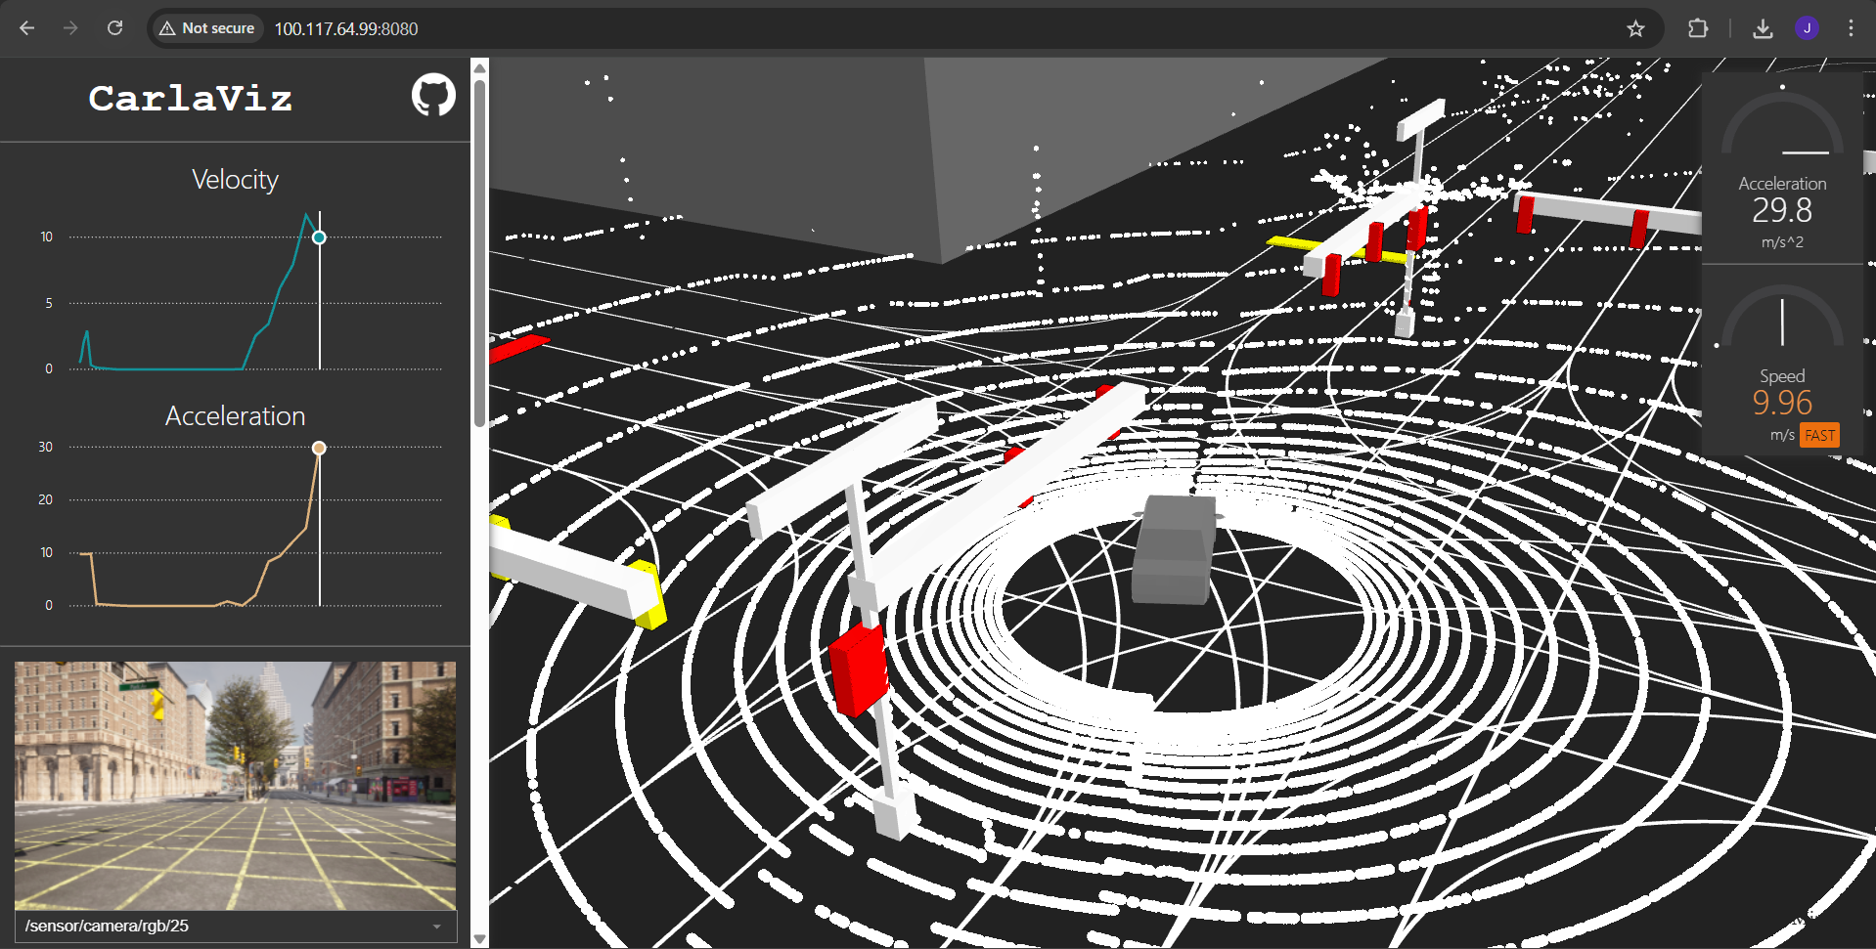
Carla Simulator
This is the driving simulator that the FYP2 project will use.

Slide 23
Conclusion and Outlook

Slide 24
Summary of Research
RQ 1
What are the differences in safety performance among different reinforcement learning algorithms in similar high-risk driving scenarios?
SAC performs relatively safely.
No absolutely optimal algorithm
The algorithm largely depends on the characteristics of the task.
RQ 2
What are the differences between different high-risk scenarios?
Highways < (left-turn intersections/intersections) < Merging < Roundabouts < (right-turn intersections/intersections)
RQ 3
What are some commonly used Transformer-based models in high-risk autonomous driving tasks?
The General Transformer is the most widely used model in the field of autonomous driving.
Transformer models can effectively integrate heterogeneous data.
Conclusion and Outlook

Slide 25
Future Outlook
FYP 2
FYP2 will focus on developing an agent that integrates the general Transformer and SAC algorithms. The goal is to minimize the vehicle collision rate in the crossroads scene, thereby improving safety.
Conclusion and Outlook

Slide 26
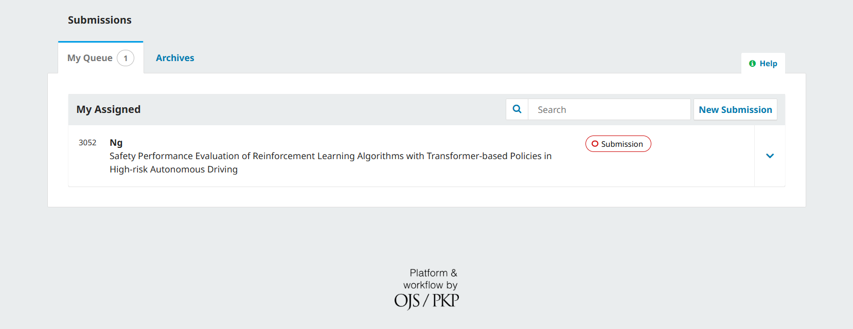
In addition to the interim report, I have synthesized my literature review findings into a formal research article. This work has been submitted to the International Journal of Robotics, Automation and Sciences (IJORAS) for peer review, and is also being entered into the MMU Press 4th International Article Writing Competition.

Slide 27
Thank you

Slide 28
Reference
Liu, H., Huang, Z., Mo, X., & Lv, C. (2024). Augmenting Reinforcement Learning With Transformer-Based Scene Representation Learning for Decision-Making of Autonomous Driving. IEEE Transactions on Intelligent Vehicles, 9(3), 4405–4421. https://doi.org/10.1109/TIV.2024.3372625
Liu, H., Huang, Z., Mo, X., & Lv, C. (2024). Augmenting Reinforcement Learning With Transformer-Based Scene Representation Learning for Decision-Making of Autonomous Driving. IEEE Transactions on Intelligent Vehicles, 9(3), 4405–4421. https://doi.org/10.1109/TIV.2024.3372625
Chowdhury, J., Shivaraman, V., Dangi, S., Sundaram, S., & Sujit, P. B. (2024). Deep Attention Driven Reinforcement Learning (DAD-RL) for Autonomous Decision-Making in Dynamic Environment. 2024 IEEE International Conference on Systems, Man, and Cybernetics (SMC), 3863–3868. https://doi.org/10.1109/SMC54092.2024.10832016
Gao, L., Tian, H., & Wu, J. (2025). Efficient Maximum Entropy Reinforcement Learning Framework Guided by Expert Policies: An Application in Autonomous Driving. IEEE Transactions on Intelligent Transportation Systems, 26(10), 15055–15067. https://doi.org/10.1109/TITS.2025.3579033
Elallid, B. B., Benamar, N., Bagaa, M., Kelouwani, S., & Mrani, N. (2024). Improving Reinforcement Learning with Expert Demonstrations and Vision Transformers for Autonomous Vehicle Control. World Electric Vehicle Journal, 15(12), 585.
Huynh, M. T., & Nguyen, D. D. (2024). SoftCTRL: Soft conservative KL-control of Transformer Reinforcement Learning for Autonomous Driving. arXiv Preprint arXiv:2410.22752.
Fan, J., Zhang, X., Zou, Y., Li, Y., Liu, Y., & Sun, W. (2024). Improving policy training for autonomous driving through randomized ensembled double Q-learning with Transformer encoder feature evaluation. Applied Soft Computing, 167, 112386.
R. Zhao, Y. Fan, Y. Li, K. Wang, C. Zheng, F. Gao, & Z. Gao. (2025). Autonomous Intersection Management via Prior-Enhanced Multi-Agent Constrained Decision Transformer. IEEE Transactions on Intelligent Transportation Systems, 26(10), 15728–15745. https://doi.org/10.1109/TITS.2025.3595526
Zhao, R., Fan, Y., Li, Y., Wang, K., Gao, F., & Gao, Z. (2024). Constraint-guided behavior transformer for centralized coordination of connected and automated vehicles at intersections. Sensors (Basel, Switzerland), 24(16), 5187.
Reference

Slide 29
Reference
Zhang, D., Luo, H., Dong, H., & Lu, J. (2025). Safety-constrained Reinforcement Learning with Interaction-aware for Decision-making of Autonomous Driving. 2025 IEEE International Conference on Multimedia and Expo (ICME), 1–6. https://doi.org/10.1109/ICME59968.2025.11209801
Yun, J., & Cao, Z. (2024). Autonomous Driving Agents for Safe Road Junctions Through Deep Reinforcement Learning. 2024 IEEE International Conference on Agents (ICA), 39–44. https://doi.org/10.1109/ICA63002.2024.00017
Prasath A, Mr. A., & Navaz K, Dr. (2025). Empirical Evaluation of Deep Learning based Autonomous Driving System with Real-Time Scene Classification Procedure. 2025 4th International Conference on Innovative Mechanisms for Industry Applications (ICIMIA), 272–278. https://doi.org/10.1109/ICIMIA67127.2025.11200907
Hu, D., Huang, C., Wu, J., & Gao, H. (2024). Pre-trained transformer-enabled strategies with human-guided fine-tuning for end-to-end navigation of autonomous vehicles. arXiv Preprint arXiv:2402.12666.
Reference

